Slide 1
Brains In Jars
Machine Learning Term Project
Hemachandra Kolisetty -14MA20015
Sarath NVP -14ME10039
Sri Keerthi B -14IE10007
Nayan Raju Vysyaraju -14MA20049
Nikitha Kondapalli -14IE10017
Sri Lekha D -14EE10014
Manasa Gogineni -14EC10018
Sharath Chandra Vemula -14EC10060

Slide 2
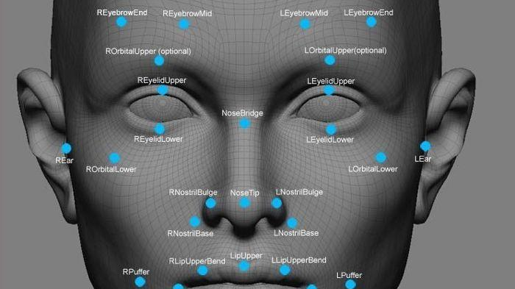
Title:
Facial Emotion Recognition

Slide 3
Problem Statement
The goal of this project is to predict, from the grayscale picture of a person’s face, which emotion the facial expression conveys. Our evaluation metric will be the accuracy for the emotions (fraction of correctly classified images). In short,
Input : 48 x 48 grayscale image of a face
Output : Emotion conveyed by facial expression

Slide 4
Methodology
Data Set
We used a dataset FER2013 provided by Kaggle website.
Type: csv file comprising label followed by pixel values of grayscale images(48x48).
Emotion Categories: Anger, Disgust, Fear, Happy, Sad, Surprise and Neutral.
Training Set: 28,709 examples Validation Set: 3,589 examples Test Set: 3,589 examples
Labels: 0=Angry, 1=Disgust, 2=Fear, 3=Happy, 4=Sad, 5=Surprise, 6=Neutral
Pre Processing
We performed central cropping to the images to get the target width and height(32x32), so that they form a bounding box around the face region.
We accounted for variation in lighting of the input images by adjusting brightness and contrast to fixed band values.
We converted the image pixel values to zero mean and unit norm with the per image whitening function.

Slide 5
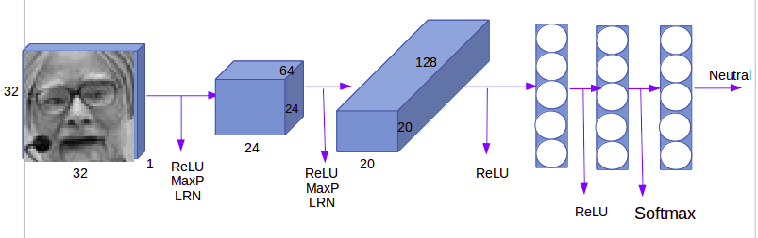
CNN Architecture
The final architecture retained can be described as follows :
9 x 9 Conv (stride 1) - ReLU - 3 x 3 Max Pool (stride 2) - LR_Norm with 64 filters
5 x 5 Conv (stride 1) - ReLU - 3 x 3 Max Pool (stride 2) - LR_Norm with 128 filters
3 FC hidden layers with ReLU activation

Slide 6
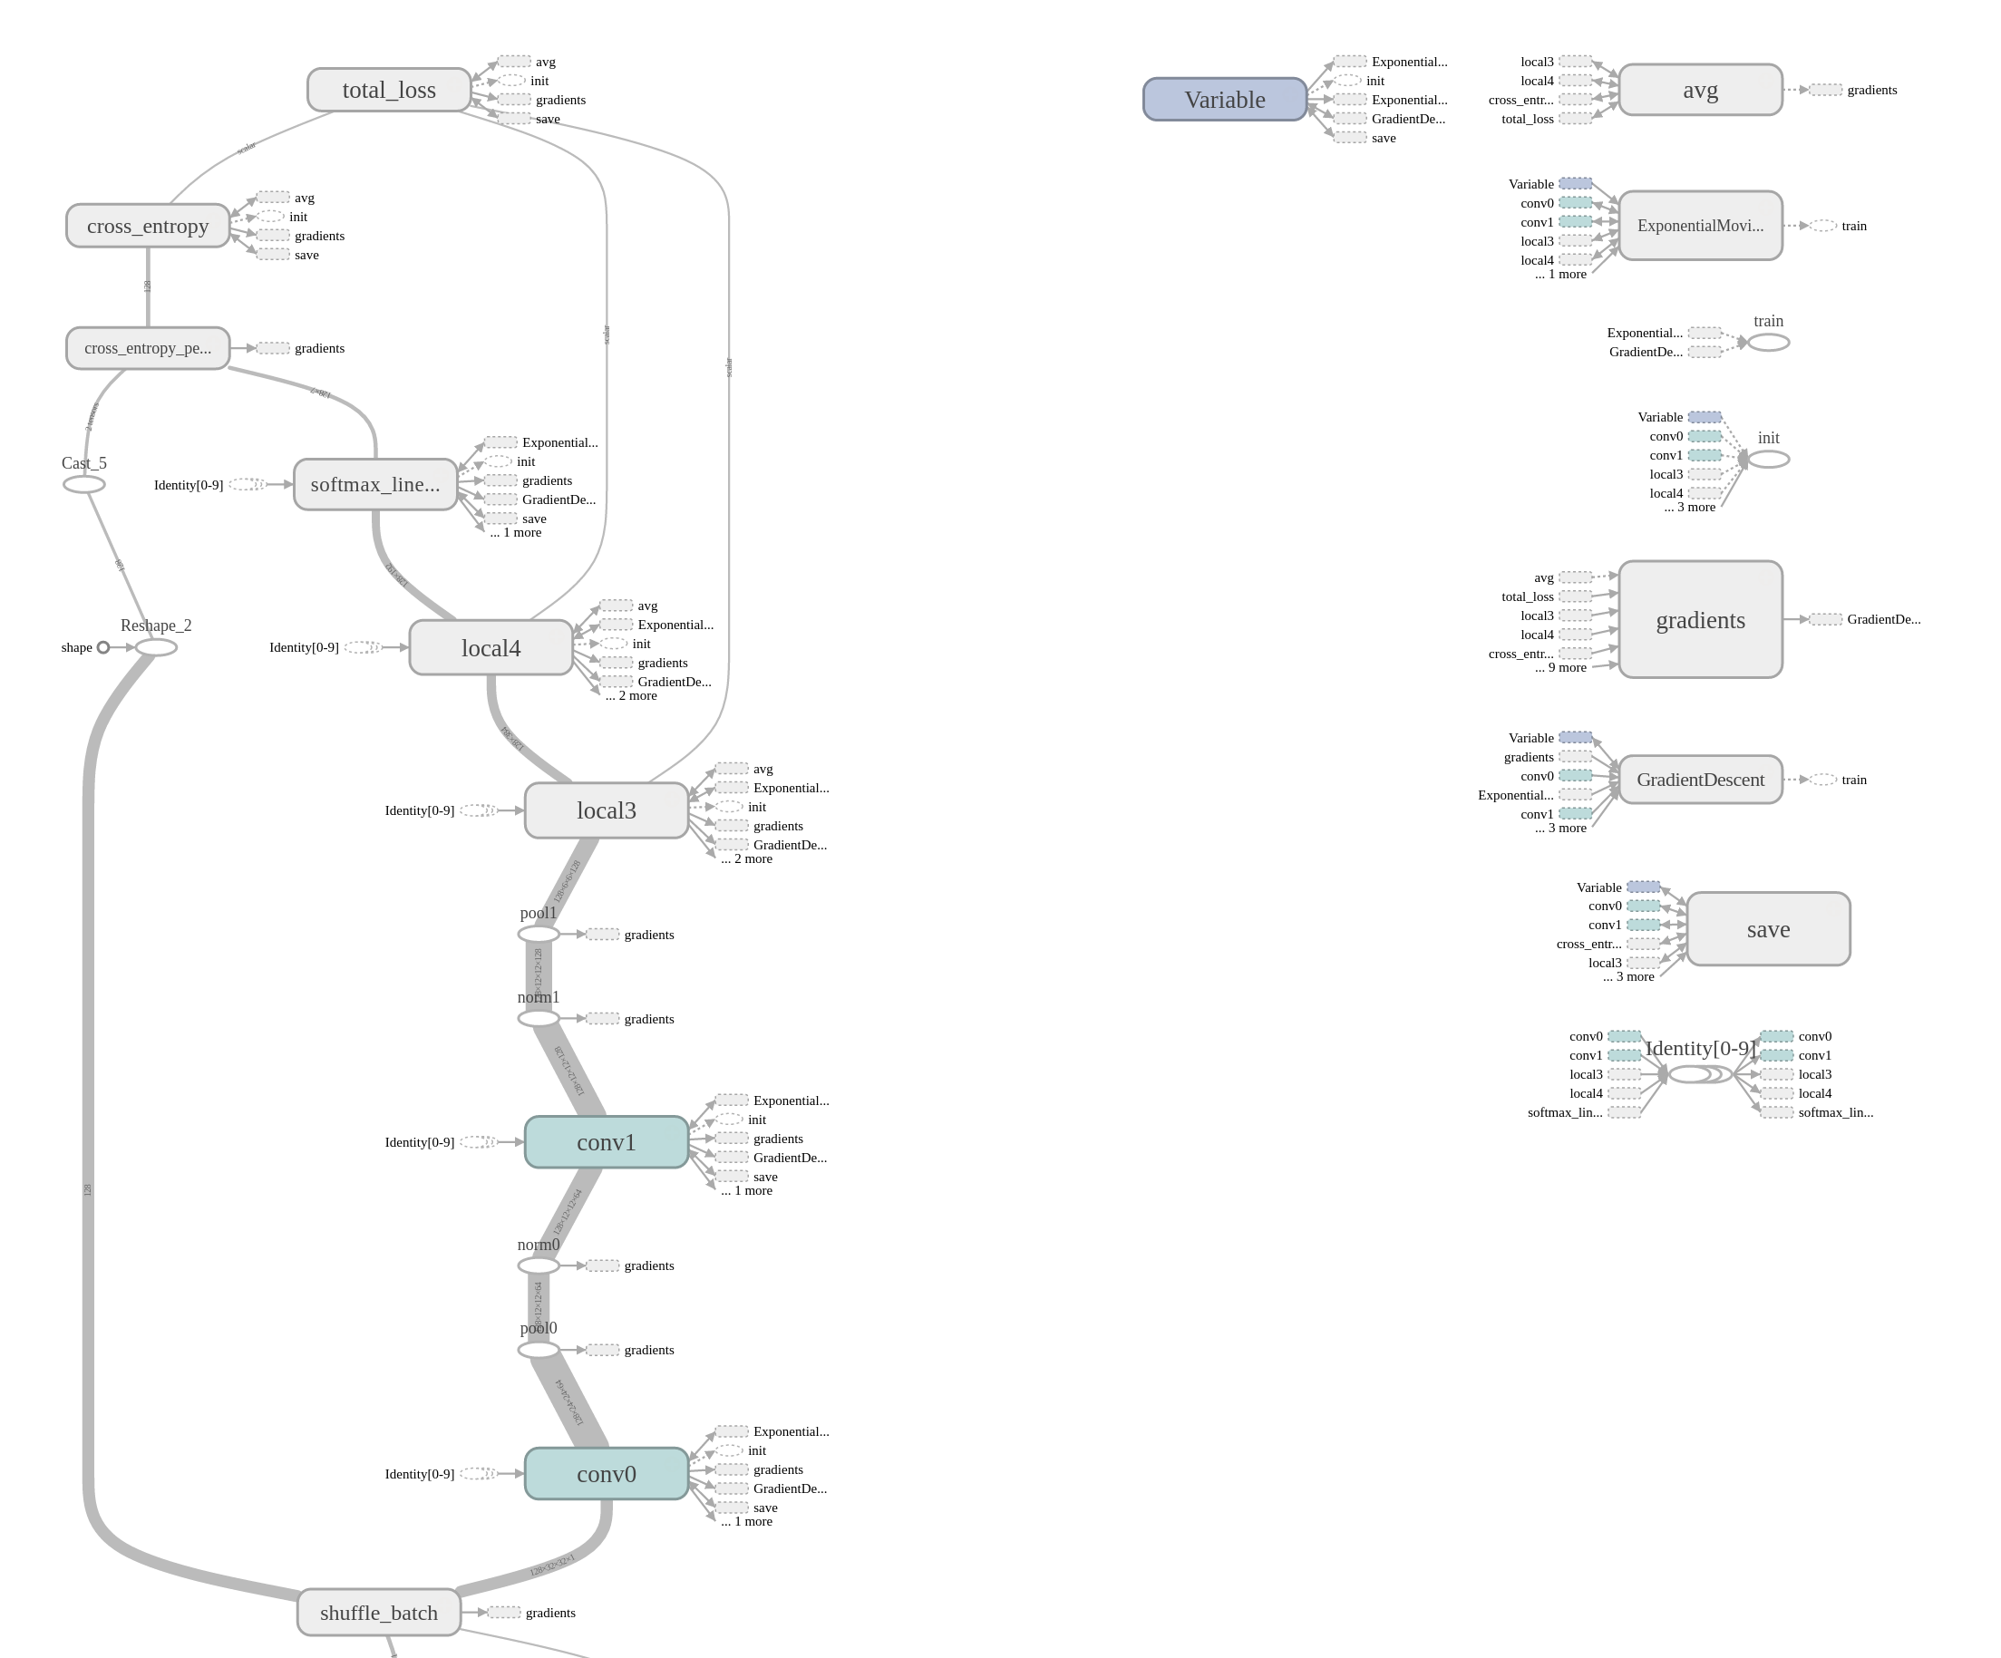
Architecture Characteristics
Exponentially decayed learning rate, L2 regularization
Local Response normalization after each layer
Gradient Descent optimiser
ReLU nonlinearity activation
9x9 convolution filter with stride 1 for first convolutional layer and 5x5 convolution filter with stride 1 for second convolutional layer
3x3 max pools with a stride of 2 for both the convolutional layers
Softmax cross-entropy to compute cost

Slide 7
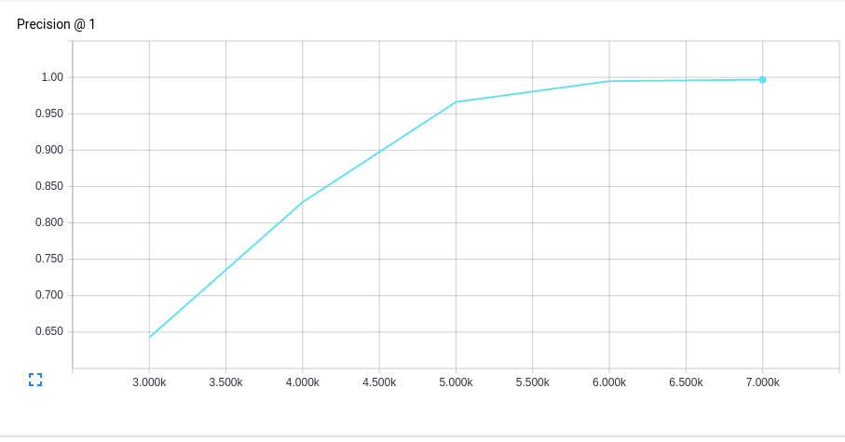
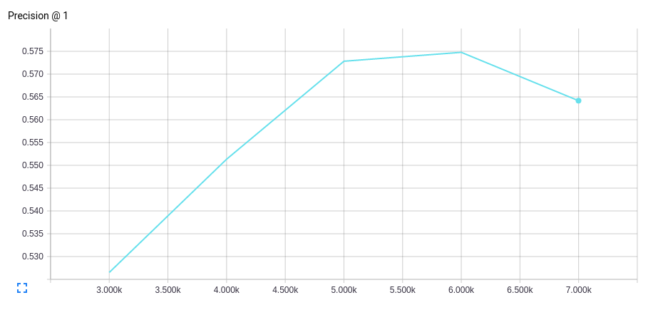
Results
We achieved final validation accuracy of 57% while the state of the art test accuracy for 7 emotion categories using deep networks is 61%, and the top Kaggle implementation received an accuracy of 71%.
Train Accuracy : 0.997
Test Accuracy : 0.57

Slide 8
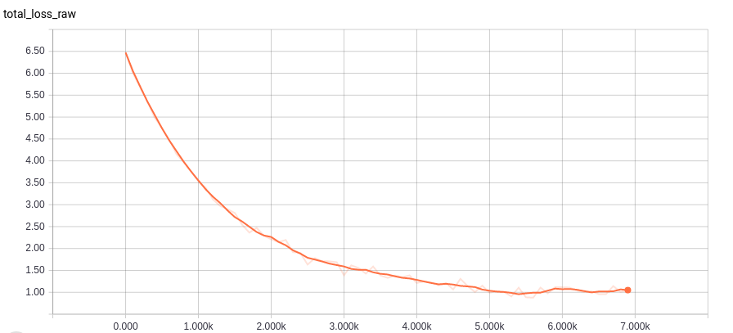
Loss Function

